Slide 1

Customer Shopping Behavior Analysis
Uncovering insights from transactional data to guide strategic business decisions.

Slide 2

Project Overview
Data Source
3,900 purchases across categories.
Goal
Uncover spending patterns, segments, preferences, subscriptions.
Impact
Guide strategic business decisions.

Slide 3

Dataset Summary
3.9K
18
Rows
Columns
Total purchases analyzed.
Key features for analysis.
Key Features
Customer demographics (Age, Gender, Location, Subscription)
Purchase details (Item, Category, Amount, Season, Size, Color)
Shopping behavior (Discount, Promo, Previous Purchases, Frequency, Review, Shipping)
Missing Data: 37 values in Review Rating.

Slide 4
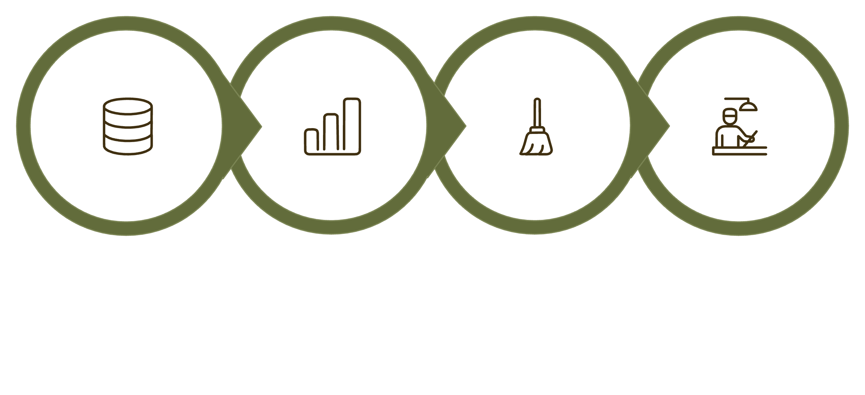

Exploratory Data Analysis (Python)
Initial Exploration
Data Cleaning
Feature Engineering
Data Loading
Data preparation and cleaning were crucial steps for accurate insights.

Slide 5
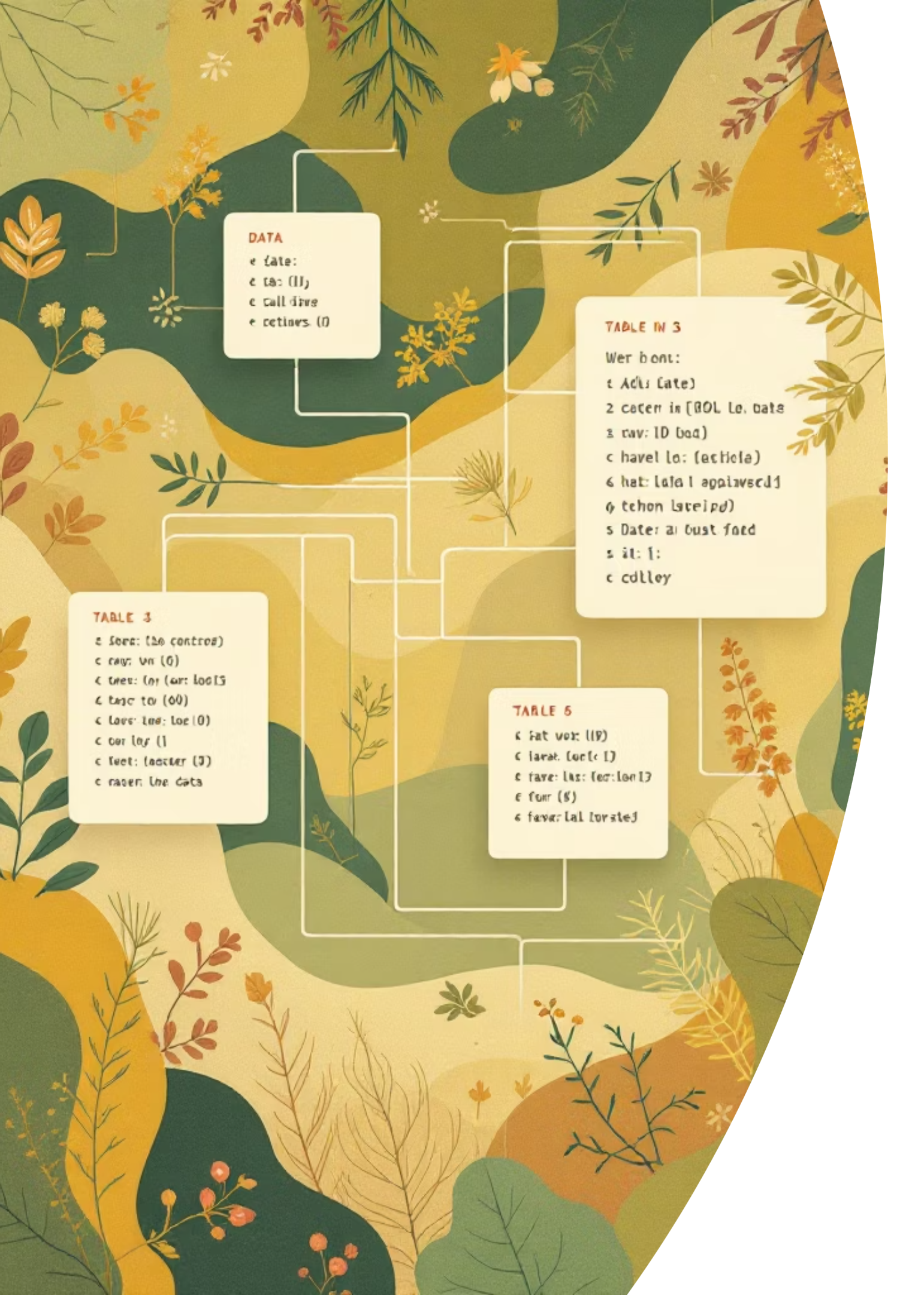
Data Analysis (SQL) - Key Findings
Revenue by Gender
Top 5 Products by Rating
Female: $75,191
Gloves: 3.86
Sandals: 3.84
Boots: 3.82
Hat: 3.80
Skirt: 3.78
Male: $157,890
High-Spending Discount Users
839 customers spent above average with discounts.

Slide 6

Shipping & Subscription Insights
Shipping Type Comparison
Subscribers vs. Non-Subscribers
Standard: $58.46 avg. purchase
Subscribers: 1,053 customers, $59.49 avg. spend, $62,645 total revenue
Non-Subscribers: 2,847 customers, $59.87 avg. spend, $170,436 total revenue
Express: $60.48 avg. purchase

Slide 7

Product & Age Group Revenue
Top 3 Products per Category
Revenue by Age Group
Young Adult: $62,143
Middle-aged: $59,197
Adult: $55,978
Senior: $55,763
Accessories: Jewelry, Sunglasses, Belt
Clothing: Blouse, Pants, Shirt
Footwear: Sandals, Shoes, Sneakers
Outerwear: Jacket, Coat

Slide 8
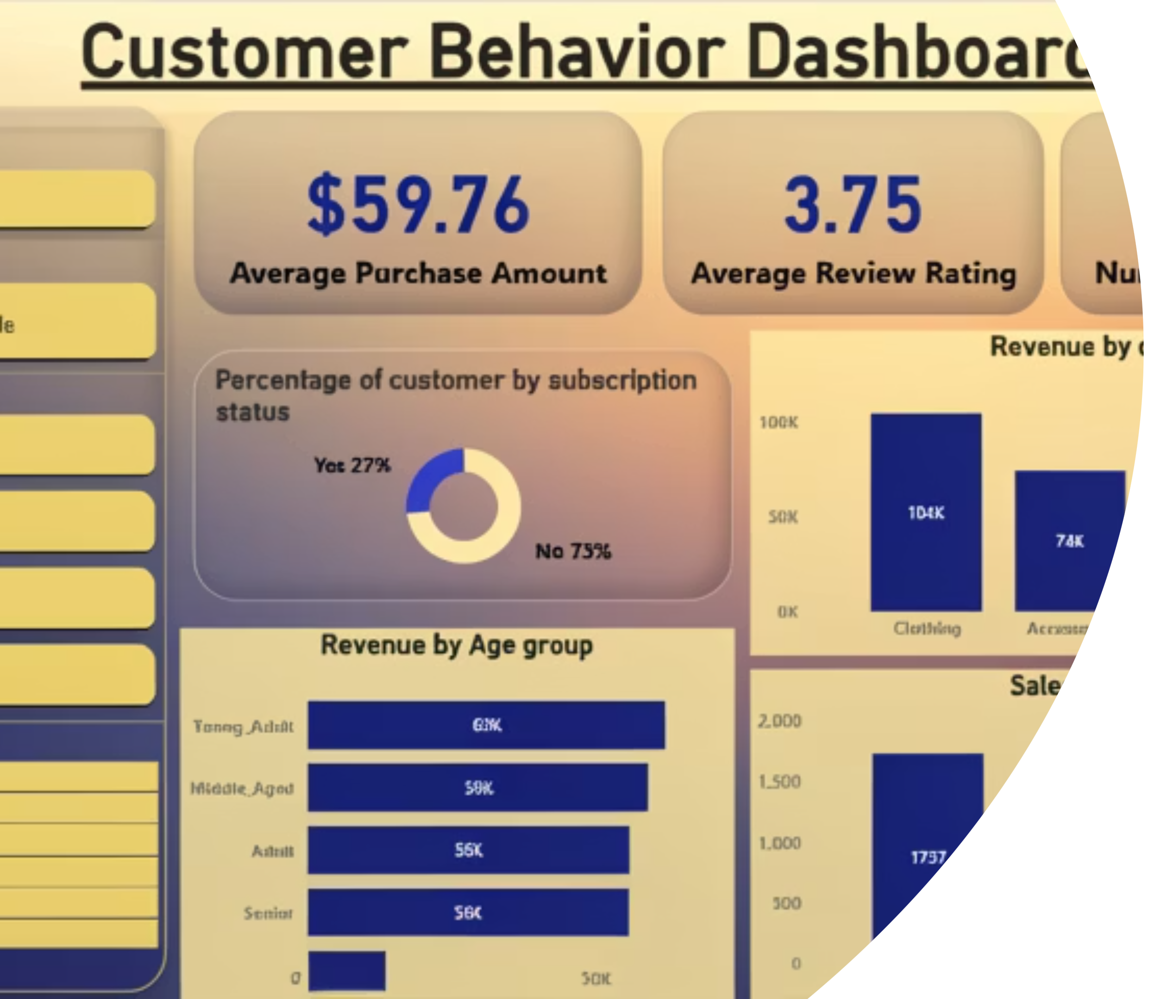
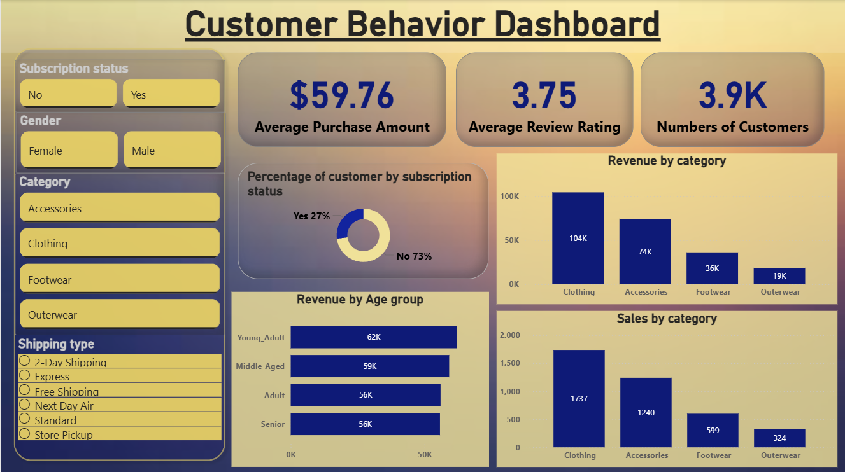
Dashboard in Power BI
Interactive dashboard for visual insights into customer behavior.

Slide 9

Business Recommendations
Boost Subscriptions
Customer Loyalty
Promote exclusive benefits.
Reward repeat buyers.
Review Discount Policy
Targeted Marketing
Balance sales with margin.
Focus on high-revenue groups.

